Slide 1
Chapter 8, Problem Plus #4
The centers of two disks with radius 1 are one unit apart. Find the area of the union of the two disks.

Slide 2
The problem is asking us to find the area of the shape to the right.
G

Slide 3


G
$$=$$
$$2 ×$$

Slide 4

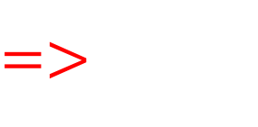


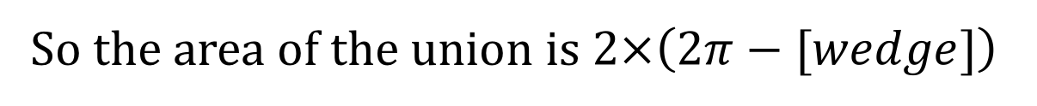

$$=$$
$$−$$
$=$>
$$π$$
$$−$$
So the area of the union is $2×\left(2π−[wedge]\right)$

Slide 5

We know that the equation of a circle in terms of x and y is
(1) $x^{2}+y^{2}=r^{2}$
$$and our value for r is 1, so we can rewrite \left(1\right) as$$
$$x^{2}+y^{2}=1$$
${1− x}^{2}=y^{2}$
$y=\sqrt{1−x^{2}}$
P
0, 1
A
B
-1, 0
C
0, 0
1, 0
Which looks like this
[the dotted line represents the perimeter of the other circle]

Slide 6







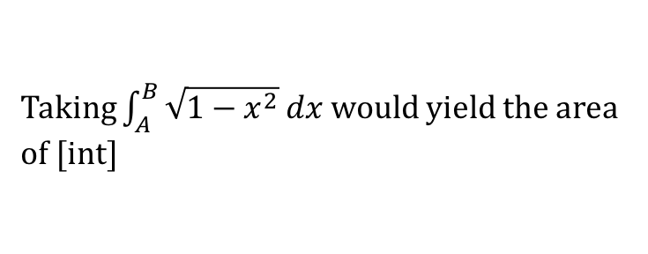



P
0, 1
Taking $\int_{A}^{B}{\sqrt{1−x^{2}} dx}$ would yield the area of [int]
A
0, $\frac{1}{2}$
B
-1, 0
C
(0, 0)
(1, 0)
By intuition, we can split [int] into the sum of [wedge] and a rectangle, [rekt]:
[int]
P
0, 1
P
0, 1
P
0, 1
A
0, $\frac{1}{2}$
B
A
0, $\frac{1}{2}$
B
A
0, $\frac{1}{2}$
B
$$=$$
$$+$$
-1, 0
C
(0, 0)
(1, 0)
-1, 0
C
(0, 0)
(1, 0)
-1, 0
C
(0, 0)
(1, 0)
[int]
[wedge]
[rekt]
Rearranging, we get
P
0, 1
P
0, 1
P
0, 1
A
0, $\frac{1}{2}$
B
$$=$$
A
0, $\frac{1}{2}$
B
$$−$$
A
0, $\frac{1}{2}$
B
-1, 0
C
(0, 0)
(1, 0)
-1, 0
C
(0, 0)
(1, 0)
-1, 0
C
(0, 0)
(1, 0)
[wedge]
[int]
[rekt]

Slide 7
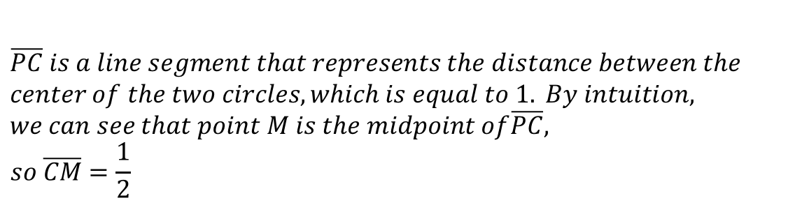

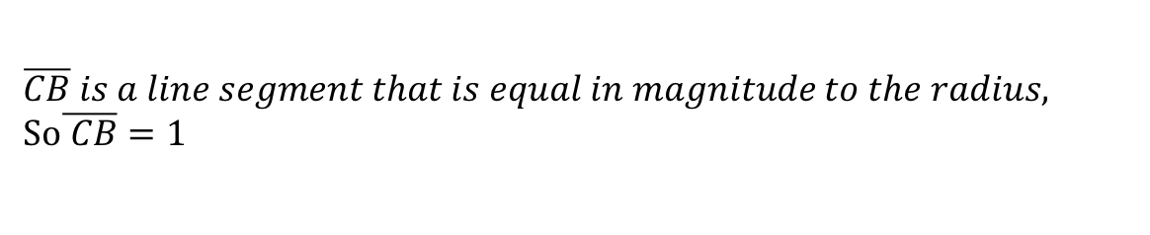
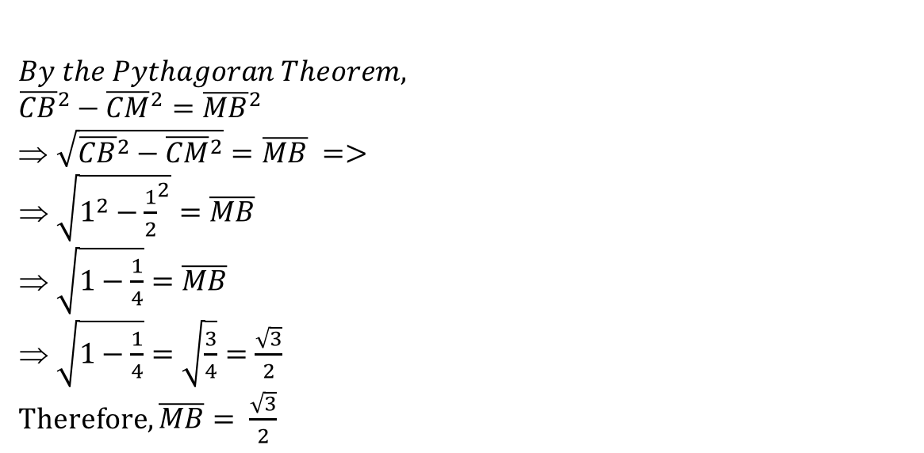
To solve for A and B, let’s use the following picture
$$\overline{CB} is a line segment that is equal in magnitude to the radius,$$
So$\overline{ CB}=1$
P
0, 1
$$\overline{PC} is a line segment that represents the distance between the$$
$$center of the two circles, which is equal to 1. By intuition,$$
$$we can see that point M is the midpoint of\overline{PC},$$
$$so \overline{CM}=\frac{1}{2}$$
A
M
B
0, $\frac{1}{2}$
$$By the Pythagoran Theorem,$$
$${\overline{CB}}^{2}−{\overline{CM}}^{2}={\overline{MB}}^{2}$$
$\sqrt{{\overline{CB}}^{2}−{\overline{CM}}^{2}}=\overline{MB} =>$
$\sqrt{1^{2}−{\frac{1}{2}}^{2}}=\overline{MB}$
$\sqrt{1−\frac{1}{4}}=\overline{MB}$
$\sqrt{1−\frac{1}{4}}=\sqrt{\frac{3}{4}}=\frac{\sqrt{3}}{2}$
Therefore, $\overline{MB}= \frac{\sqrt{3}}{2}$
-1, 0
C
0, 0
1, 0

Slide 8
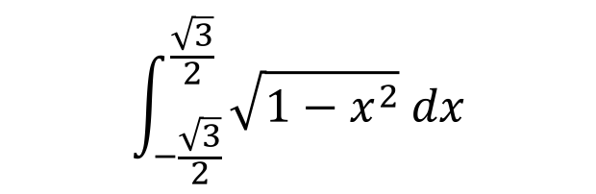


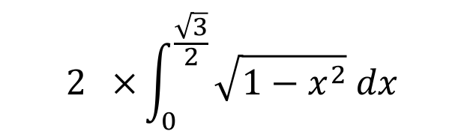



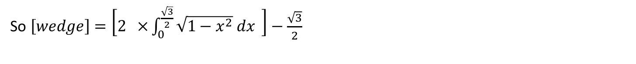

So $A=−\frac{\sqrt{3}}{2}, B=\frac{\sqrt{3}}{2}$
P
0, 1
By properties of integrals
$$\int_{−\frac{\sqrt{3}}{2}}^{\frac{\sqrt{3}}{2}}{\sqrt{1−x^{2}} dx}$$
$$2 ×\int_{0}^{\frac{\sqrt{3}}{2}}{\sqrt{1−x^{2}} dx}$$
A
0, $\frac{1}{2}$
B
$$=$$
$$=$$
-1, 0
C
(0, 0)
(1, 0)
[int]
P
0, 1
A
B
$$\sqrt{3} × \frac{1}{2} = \frac{\sqrt{3}}{2}$$
0, $\frac{1}{2}$
$$=$$
-1, 0
C
(0, 0)
(1, 0)
[rekt]
So $\left[wedge\right]=\left[2 ×\int_{0}^{\frac{\sqrt{3}}{2}}{\sqrt{1−x^{2}} dx} \right]−\frac{\sqrt{3}}{2}$

Slide 9

To evaluate $\int_{0}^{\frac{\sqrt{3}}{2}}{\sqrt{1−x^{2}} dx}$,
Let $1−x^{2}$ =${({\cos{θ}})}^{2}=1−{(sin{θ})}^{2}$ (A) by trig-(1)
${(sin{θ})}^{2}$ =${ x}^{2}$
$\sin{θ}=x ⇒$ $θ$=$\sin^{−1}{x}, so when x=0,$ $θ$ = $\sin^{−1}{0}=0$ and when $x$= $\frac{\sqrt{3}}{2}$, $θ$ = $\sin^{−1}{\frac{\sqrt{3}}{2}}= \frac{π}{3}$ (B)
Taking the derivative, $\cos{θ dθ=dx}$ (C)
By (A), (B), and (C), and using the substitution rule, $\int_{0}^{\frac{\sqrt{3}}{2}}{\sqrt{1−x^{2}} dx}$ =$\int_{0}^{\frac{π}{3}}{\sqrt{{\left(\cos{θ}\right)}^{2}}×\cos{θ}dθ}$
$\int_{0}^{\frac{π}{3}}{{(cos{θ)}}^{2} dθ}$

Slide 10

To evaluate $\int_{0}^{\frac{π}{3}}{{(cos{θ)}}^{2} dθ}$, we can use trig-(3), which states that ${(cos{θ)}}^{2}$ = $\frac{1}{2}(1+\cos{2θ}$)
$\frac{1}{2} ×\int_{0}^{\frac{π}{3}}{1+\cos{2θ} dθ}$ = $\frac{1}{2}$ $×$ $\left(θ\text{ + }\frac{1}{2} \sin{2θ}+C\left.{\frac{π}{3} \atop 0}\right]\right)=\frac{θ}{2}\text{+ }\frac{1}{4} \sin{2θ}+C\left.{\frac{π}{3} \atop 0}\right]$ by FTOC
$\frac{π}{6}+\left(\frac{1}{4}×\sin{\frac{2π}{3}}\right) −0 −\left(\frac{1}{4}×\sin{0}\right)= \frac{π}{6}+\frac{\sqrt{3}}{8}$
Therefore, $\int_{0}^{\frac{\sqrt{3}}{2}}{\sqrt{1−x^{2}} dx}=\frac{π}{6}+\frac{\sqrt{3}}{8}$

Slide 11




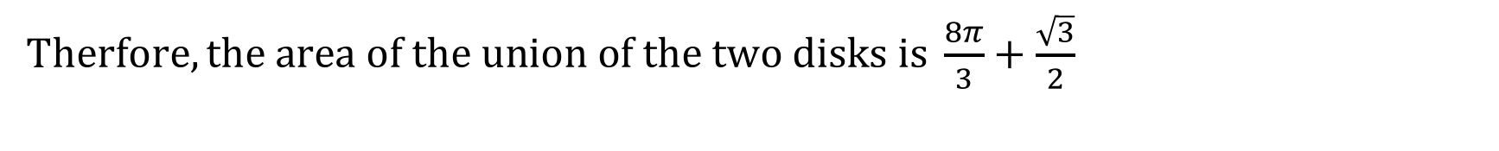

$$\frac{π}{3}+\frac{\sqrt{3}}{4} −\frac{\sqrt{3}}{2}$$
$$\frac{π}{3}−\frac{\sqrt{3}}{4}$$
[wedge]$=\left[2 ×\left(\frac{π}{6}+\frac{\sqrt{3}}{8}\right)\right] − \frac{\sqrt{3}}{2}$
$$=$$
$$=$$
A$rea of union=2×\left[π−[wedge]\right]=2×\left[π−\frac{π}{3}+\frac{\sqrt{3}}{4}\right]=2×\left[\frac{4π}{3}+\frac{\sqrt{3}}{4}\right]=\frac{8π}{3}+\frac{\sqrt{3}}{2}$
T$herfore, the area of the union of the two disks is \frac{8π}{3}+\frac{\sqrt{3}}{2}$

Slide 12
References: Stewart, James, Calculus 6th edition

